Slide 1
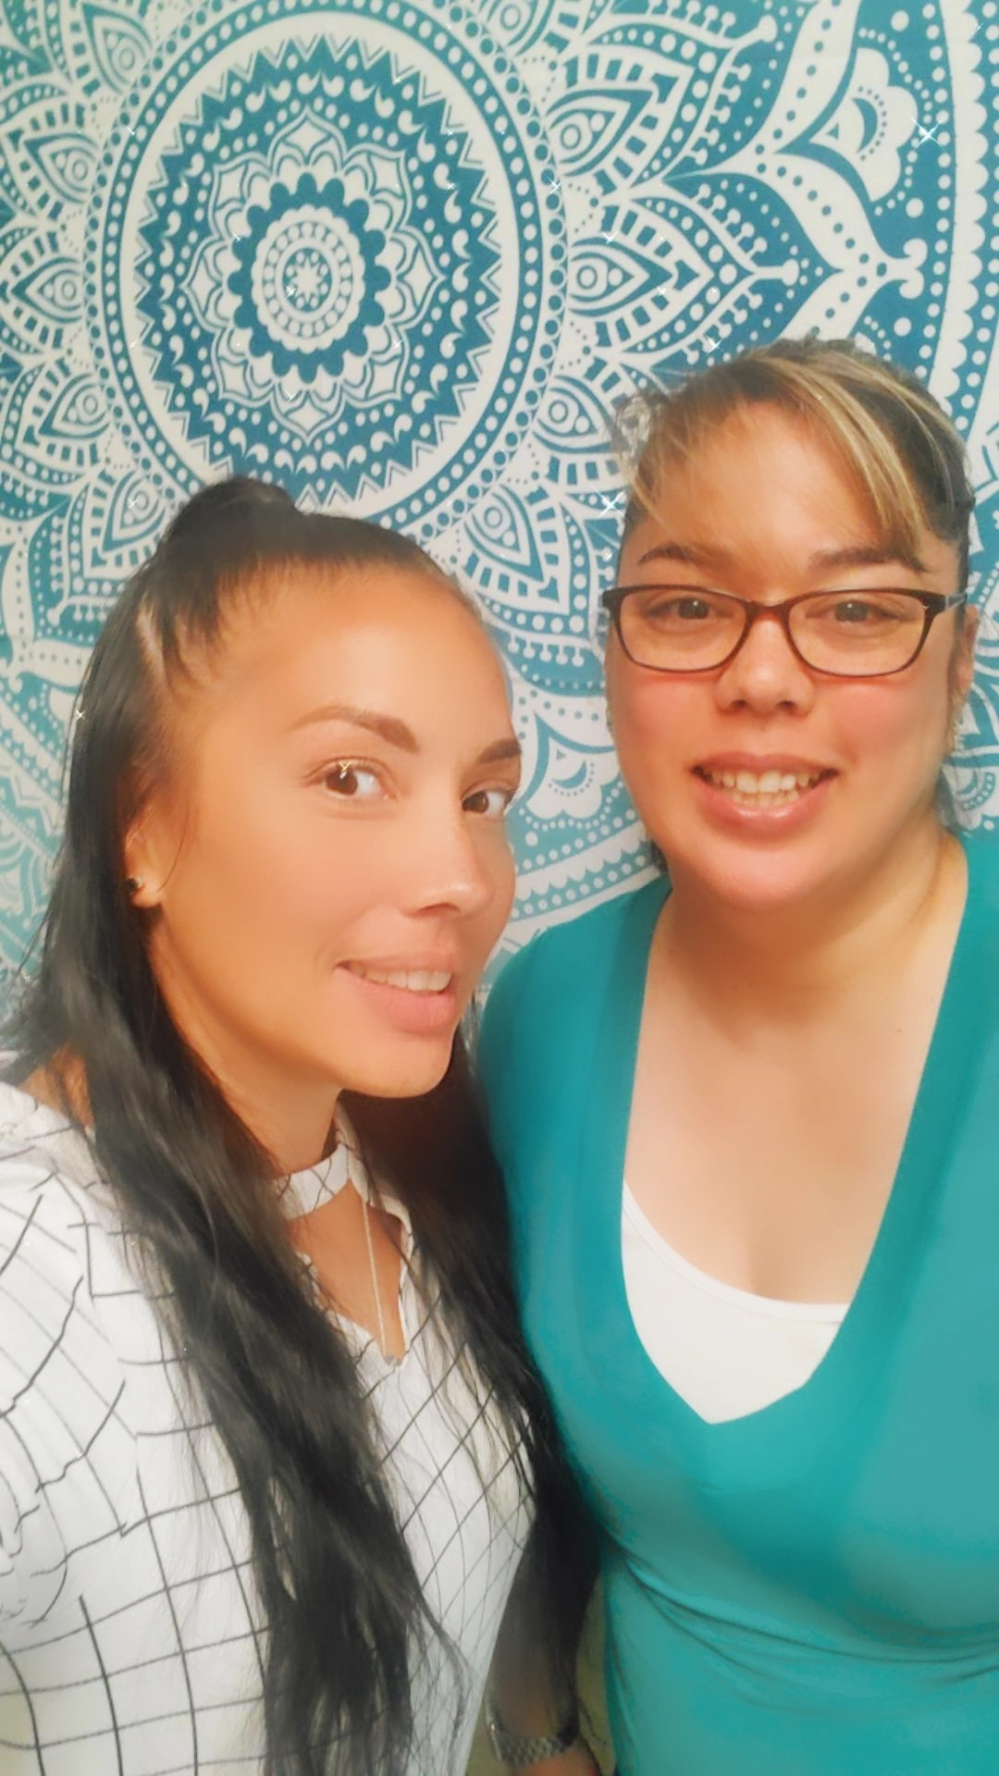
Meet Montezuma’s Mental Health Clinicians
Mercedes Corona, LMFT47786
Mental Health Clinician
District Cell #: (209) 662-5871
MCorona@stocktonusd.net
Marie Johnson, LMFT114804
Mental Health Clinician
District Cell #: (209) 662-5876
MAJohnson@stocktonusd.net
Notes:
Picture of workbook

Slide 2
Family Wellness Kits were created by the SUSD Mental Health & Behavior Support Services Department to support the social emotional growth of its students and families
Designed for parents and caregivers to support new learning of wellness tools that to support the development of positive relationships and resiliency
Information and resources regarding mental health and other community resources are included
Available FREE to SUSD Families
Available in English and Spanish
Khmer and Hmong (late Fall 2021)
Notes:
The Mental Health & Behavior Support Services Department believes that family wellness is key in supporting a child's success in school. When we address a child’s social emotional needs we will see better behavioral, educational, and relationship outcomes.

Slide 3
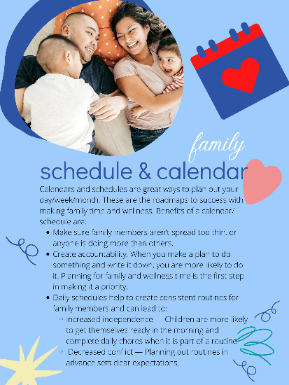
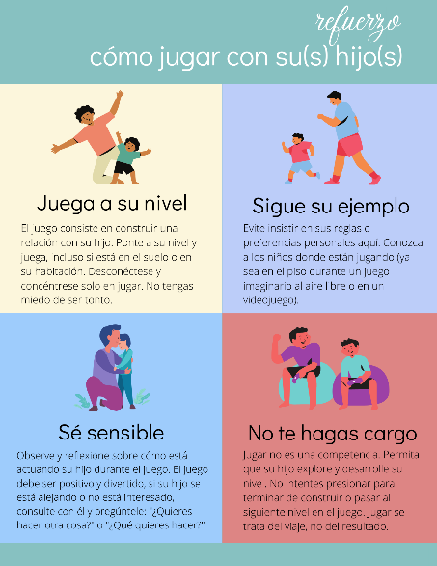
Start with the Parent & Caregiver Workbook as your guide to goal setting, positive reinforcement, and new skills and practice activities for parents and caregivers to do with their children help support family growth.
Sections Include:
How to use this Kit
Calendars & Schedules
Positive Reinforcement
Mindful Breathing
Empathy
Communication
Super Solver (collaborative problem solving)
Additional Resources
Notes:
Picture of cards

Slide 4
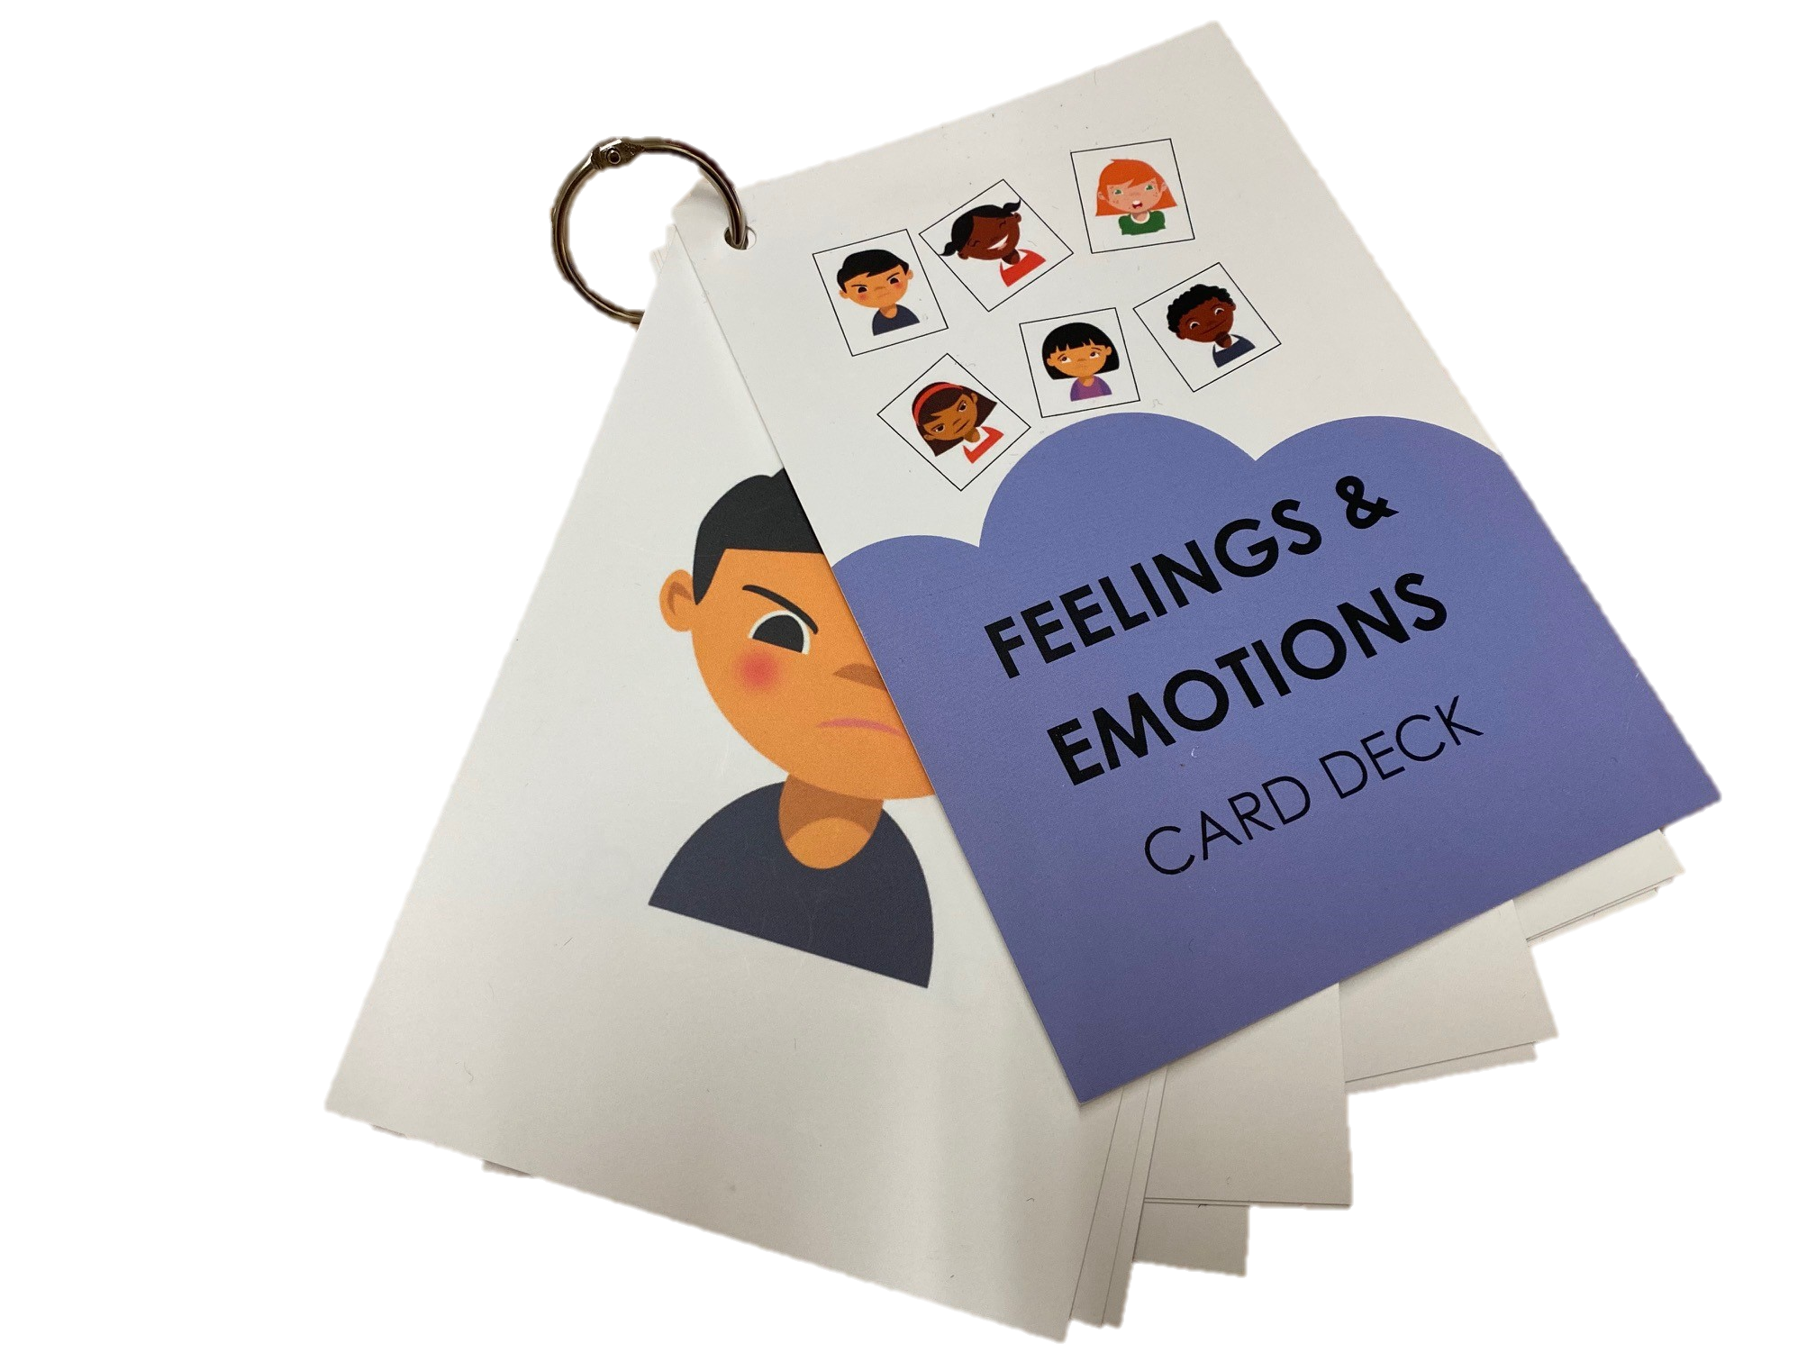
All the materials needed to do all the activities are included
Supplemental Materials
Family Activity Card Deck
Would You Rather? Card Deck
Feelings & Emotions Card Deck
How Are You Feeling? Chart
Think It or Say It? Chart
How Big or Small Is the Problem? Chart
Family Calendar
Sample Family Wellness Kit Activity Calendar
Additional Support Resources
COMPANION WEBPAGE
Contains all printed materials included in the kit
Short videos modeling the skills (multiple languages will be available)
Notes:
Picture of workbook

Slide 5
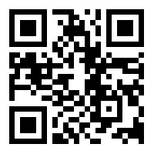
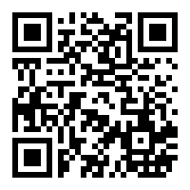
HOW DO I GET ONE?
Registration is available via Google Forms:
https://qrgo.page.link/iM3Wy
If you would like a paper registration form, please see your school site Mental Health Clinician
Check out our Family Wellness Kit companion webpage!
www.stocktonusd.net/familywellness
The companion webpage contains all printed materials included in the kit, as well as view short videos modeling the skills (multiple languages will be available)

Slide 6
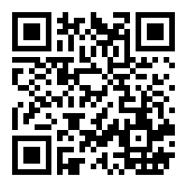
Check Out the Mental Health & Behavior Support Services Webpage!
The Mental Health & Behavior Support Services department periodically updates their webpage with useful information and resources related to supporting social emotional and behavioral needs of children and families. Please visit the Resources tab on the Mental Health & Behavior Support Services Department webpage at: www.stocktonusd.net/mhbss for the following resources
Resources for parents in supporting their students regarding COVID 19
Mental Health Resources for families supporting students
PBIS Resources for families
Behavior Resources for families
Emergency contact information
LGBTQ+ Resources
Trauma –Informed Supports
Mindfulness Supports
Instant Coffee Talk (Videos trainings available 24/7)
MH&BSS Training Calendar
Notes:
The Mental Health & Behavior Support Services Department believes that family wellness is key in supporting a child's success in school. When we address a child’s social emotional needs we will see better behavioral, educational, and relationship outcomes.

Slide 7
Conoce al terapeuta de salud mental
Mercedes Corona, LMFT47786
Mental Health Clinician
District Cell #: (209) 662-5871
MCorona@stocktonusd.net
Marie Johnson, LMFT114804
Mental Health Clinician
District Cell #: (209) 662-5876
MAJohnson@stocktonusd.net
Notes:
Picture of workbook

Slide 8
Los kits de bienestar familiar fueron creados por el Departamento de Servicios de Apoyo de Conducta y Salud Mental del SUSD para apoyar el crecimiento socioemocional de sus estudiantes y familias.
Diseñado para padres y cuidadores para apoyar el aprendizaje de nuevas herramientas de bienestar que apoyan el desarrollo de relaciones positivas y resiliencia.
Se incluyen información y recursos relacionados con la salud mental y otros recursos comunitarios.
Disponible GRATIS para familias del SUSD
Disponible en inglés y español.
Khmer y Hmong (finales del otoño de 2021)
Notes:
The Mental Health & Behavior Support Services Department believes that family wellness is key in supporting a child's success in school. When we address a child’s social emotional needs we will see better behavioral, educational, and relationship outcomes.

Slide 9
Comience con el Libro de trabajo para padres y cuidadores como su guía para el establecimiento de metas, el refuerzo positivo y nuevas habilidades y actividades de práctica para que los padres y cuidadores las realicen con sus hijos y ayuden a apoyar el crecimiento familiar.
Las secciones incluyen:
Cómo utilizar este kit
Calendarios y horarios
Refuerzo positivo
Respiración consciente
Empatía
Comunicación
Super Solver (resolución colaborativa de problemas)
Recursos adicionales
Notes:
Picture of cards

Slide 10
Se incluyen todos los materiales necesarios para realizar todas las actividades.
Materiales suplementarios
Baraja de cartas de actividades familiares
¿Que prefieres? Baraja de cartas
Baraja de cartas de sentimientos y emociones
¿Como te sientes? Gráfico
Piénselo o dígalo? Gráfico
¿Qué tan grande o pequeño es el problema? Gráfico
Calendario familiar
Ejemplo de calendario de actividades del kit de bienestar familiar
Recursos de soporte adicionales
PÁGINA WEB COMPLEMENTARIA
Contiene todos los materiales impresos incluidos en el kit
Videos cortos que modelan las habilidades (estarán disponibles varios idiomas)
Notes:
Picture of workbook

Slide 11
¿CÓMO CONSIGO UNO?
El registro está disponible a través de Formularios de Google:
https://qrgo.page.link/iM3Wy
Si desea un formulario de registro en papel, consulte con el terapeuta salud mental de su escuela.
¡Visite nuestra página web complementaria del Kit de bienestar familiar!
www.stocktonusd.net/familywellness
La página web complementaria contiene todos los materiales impresos incluidos en el kit, además de ver videos cortos que modelan las habilidades (habrá varios idiomas disponibles)

Slide 12
¡Visite la página web de Servicios de apoyo para la salud mental y la conducta!
El departamento de Servicios de apoyo para la salud mental y la conducta actualiza periódicamente su página web con información y recursos útiles relacionados con el apoyo a las necesidades socioemocionales y conductuales de los niños y las familias. Visite la pestaña de Recursos en la página web del Departamento de Servicios de Apoyo a la Salud Mental y la Conducta en: www.stocktonusd.net/mhbss para obtener los siguientes recursos
Recursos para que los padres apoyen a sus estudiantes con respecto a COVID 19​
Recursos de salud mental para familias que apoyan a los estudiantes​
Recursos PBIS para familias​
Recursos de comportamiento para familias​
Información de contacto de emergencia​
Recursos LGBTQ +​
Trauma: apoyos informados​
Apoyos de la atención plena​
Instant Coffee Talk (videos de capacitación disponibles las 24 horas, los 7 días de la semana)​
Calendario de formación de MHBSS​
Notes:
The Mental Health & Behavior Support Services Department believes that family wellness is key in supporting a child's success in school. When we address a child’s social emotional needs we will see better behavioral, educational, and relationship outcomes.

